Slide 1


Statistics Essentials
Refer & Earn
up to ₹ 5,000/- per referral

Slide 2

Overview of Statistics
Module - 1

Slide 3
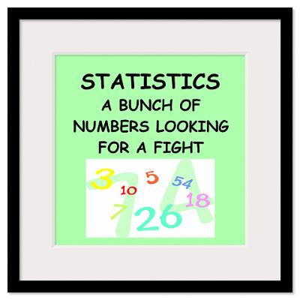
Statistics for Data
The science of collecting, describing, and interpreting data is popularly known as Statistical leveraging in Data Science.
Two areas of Statistics:
Descriptive statistics – Methods of organizing, summarizing, and presenting data in an informative way
Inferential statistics – The methods used to determine something about a population on the basis of a sample

Slide 4

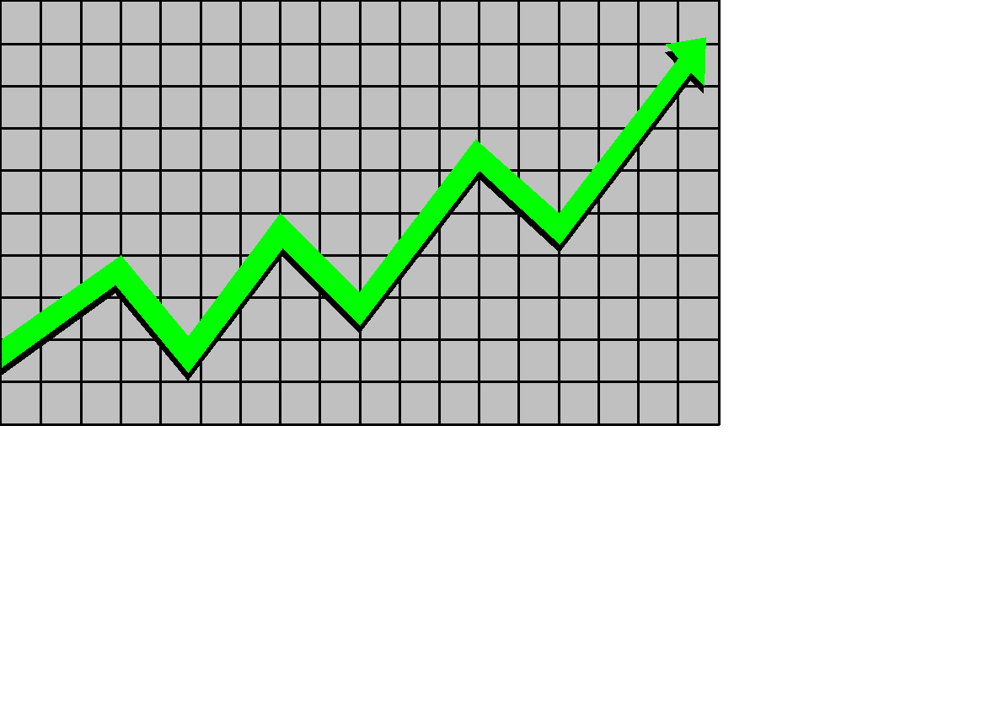
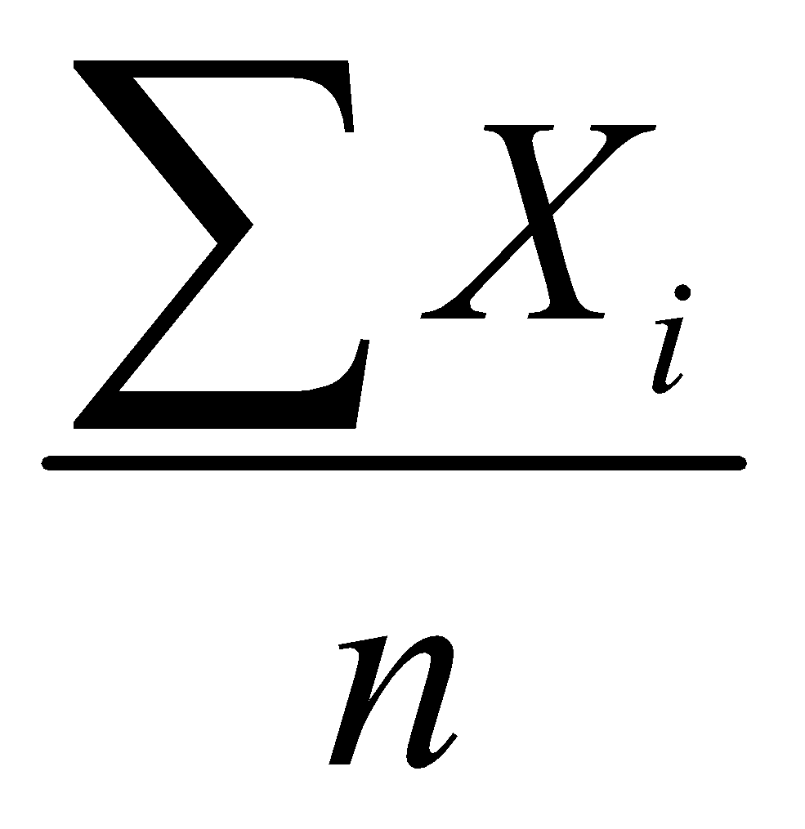
Descriptive Statistics
Descriptive statistics are methods for organizing and summarizing data.
For example, tables or graphs are used to organize data, and descriptive values such as the average score are used to summarize data.
A descriptive value for a population is called a parameter and a descriptive value for a sample is called a statistic.
Collect data
  e.g., Survey
Present data
  e.g., Tables and graphs
Summarize data
e.g., Sample mean =

Slide 5
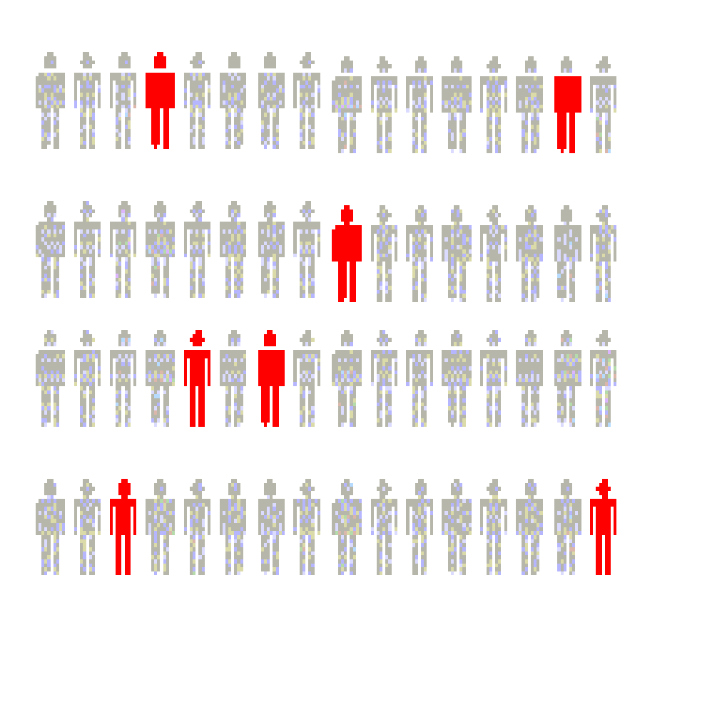
Inferential Statistics
Inferential statistics are methods for using sample data to make general conclusions (inferences) about populations.
Because a sample is typically only a part of the whole population, sample data provide only limited information about the population. As a result, sample statistics are generally imperfect representatives of the corresponding population parameters.
Estimation
  e.g., Estimate the population mean weight using the sample mean weight
Hypothesis testing
  e.g., Test the claim that the population mean weight is 70 kg
Inference is the process of drawing conclusions or making decisions about a population based on sample results

Slide 6
Definitions of Basic Terms
Population: A collection, or set, of individuals or objects or events whose properties are to be analyzed.
Two kinds of populations: finite or infinite.
Sample: A subset of the population.
Variable: A characteristic about each individual element of a population or sample.
Data (singular): The value of the variable associated with one element of a population or sample. This value may be a number, a word, or a symbol.

Slide 7
Definitions of Basic Terms
Data (plural): The set of values collected for the variable from each of the elements belonging to the sample.
Random Variable: Placeholder to store values - a number, string, or object that may vary
Experiment: A planned activity whose results yield a set of data.
Parameter: A numerical value summarizing all the data of an entire population.
Statistic: A numerical value summarizing the sample data.

Slide 8
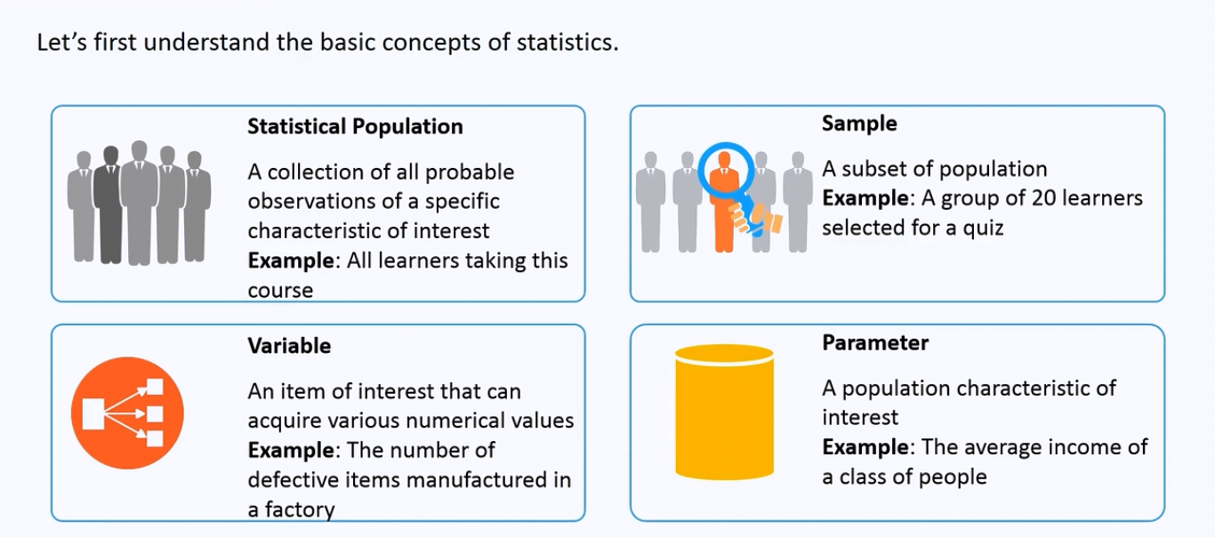
Examples

Slide 9
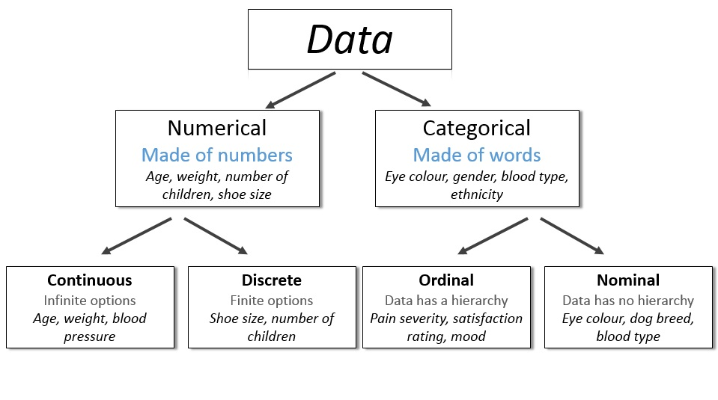
Types of Data

Slide 10
Examples of variables
Example: Identify each of the following as examples of qualitative or numerical variables:
1. The temperature in Barrow, Alaska at 12:00 pm on any
given day.
2. The model of automobile.
3. Whether or not a 6 volt lantern battery is defective.
4. The weight of a lead pencil.
5. The length of time billed for a long distance telephone call.
6. The brand of cereal children eat for breakfast.
7. The type of book taken out of the library by an adult.

Slide 11
Examples of variables…
Example: Identify each of the following as examples of
nominal, (2) ordinal, (3) discrete, or (4) continuous variables:
The length of time until a pain reliever begins to work.
The number of chocolate chips in a cookie.
The number of colors used in a statistics textbook.
The brand of refrigerator in a home.
The overall satisfaction rating of a new car.
The number of files on a computer’s hard disk.
The pH level of the water in a swimming pool.
The number of staples in a stapler.

Slide 12
Harnessing Data
Module - 2

Slide 13
Steps Involved In Descriptive Statistics
Collecting the data
Presenting the data → Visualization using BI or Python
Summarizing the data → EDA (Module 3)

Slide 14
Making sense of the data
A sample drawn from a population should have characteristics similar to the population.
Sampling can be:
with replacement: a member of the population may be chosen more than once
without replacement: a member of the population may be chosen only once (lottery ticket)

Slide 15
Collecting The Data
Step1:-Define the object or aim of the experiment.
i.e Estimate the average life of electronic component
Step2:-Define the variable and population of interest.
i.e usage,power rating,battery life etc
Step3:-Defining the data collection scheme and data measuring scheme.
i.e sampling procedure,sample size,data measuring device.
Step4:-Defining the appropriate descriptive and inferential analysis techniques

Slide 16
Methods Used To Collect Data
Experiment: The investigator controls or modifies the environment and observes the effect on the variable under study.
Survey: Data are obtained by sampling some of the population of interest. The investigator does not modify the environment.
Census: A 100% survey. Every element of the population is listed. Seldom used: difficult and time-consuming to compile, and expensive.
Judgment Samples: It is a non-probability sampling technique in which the sample members are chosen only on the basis of the researcher's knowledge and judgment.
Probability Samples: Samples in which the elements to be selected are drawn on the basis of probability. Each element in a population has a certain probability of being selected as part of the sample.

Slide 17
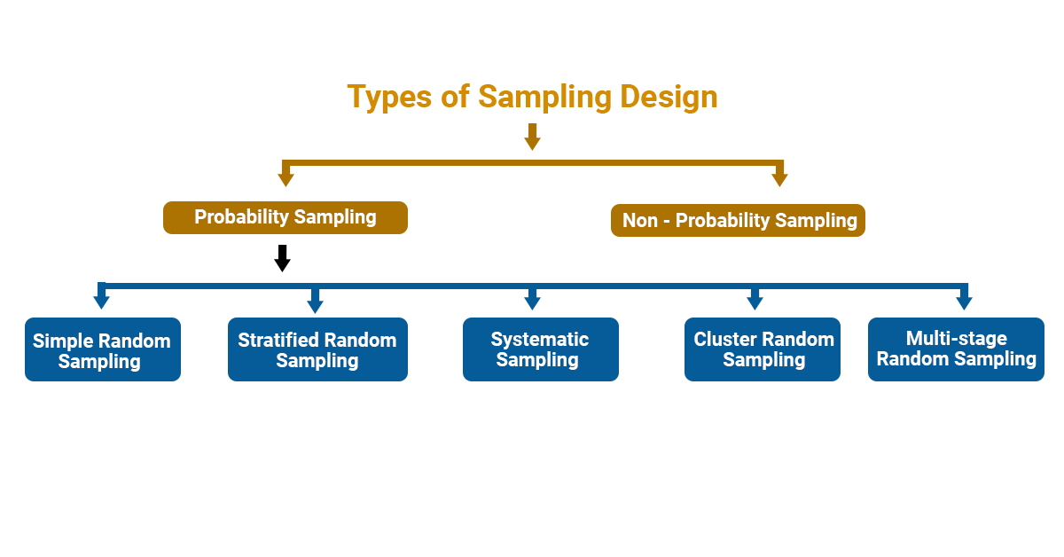
Types Of Sampling

Slide 18
Probability Sampling
1. Simple Random sampling :-each sample of the same size has an equal chance of being selected.
2. Stratified Sampling :-divide the population into groups called strata and then take a sample from each stratum.
3. Cluster sampling :-divide the population into strata and then randomly select some of the strata. All the members from these strata are in the cluster sample.
4. Systematic sampling :-randomly select a starting point and take every n-th piece of data from a listing of the population.
5. Multistage Random :- divide the population into clusters and select some clusters at the first stage. At each subsequent stage, you further divide up those selected clusters into smaller clusters, and repeat the process until you get the desired sample size.

Slide 19
Sampling Example
Example: An employer is interested in the time it takes each employee to commute to work each morning. A random sample of 35 employees will be selected and their commuting time will be recorded.
There are 2712 employees.
Each employee is numbered: 0001, 0002, 0003, etc. up to 2712.
Using four-digit random numbers, a sample is identified: 1315, 0987, 1125, etc.

Slide 20
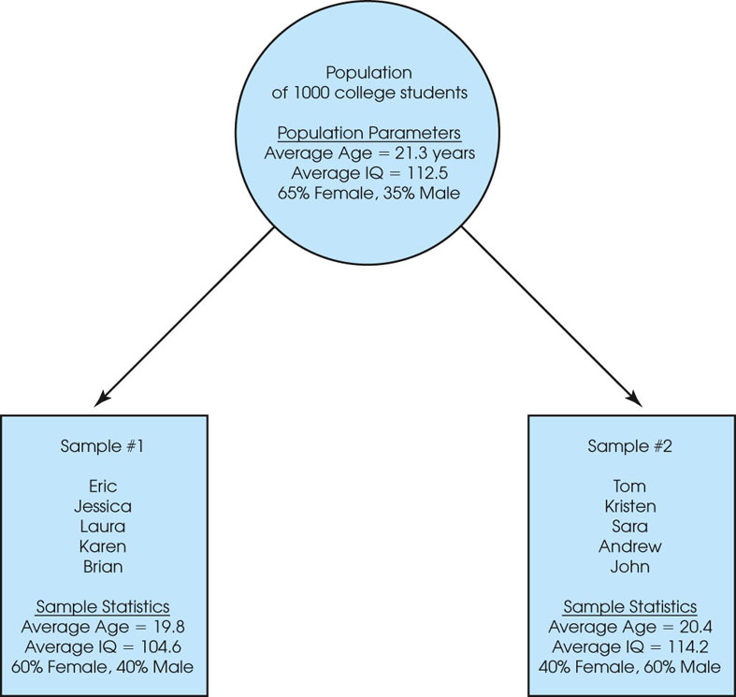
Sampling Error
The discrepancy between a sample statistic and its population parameter is called sampling error.
Defining and measuring sampling error is a large part of inferential statistics
Figure 1.2
A demonstration of sampling error. Two samples are selected from the same population. Notice that the sample statistics are different from one sample to another, and all of the sample statistics are different from the corresponding population parameters. The natural differences that exist, by chance, between a sample statistic and a population parameter are called sampling error.

Slide 21
Exploratory Analysis
Module - 3

Slide 22
Measures of Central Tendencies

Slide 23
Central Tendency
The property of data being concentrated in the centre.

Slide 24
Measures of Central Tendency
Mean
Median
Mode

Slide 25
Mean
The mean is the average of all numbers and is sometimes called the arithmetic mean.

Slide 26
Median
The statistical median is the middle number in a sequence of numbers. To find the median, organize each number in order by size; the number in the middle is the median

Slide 27
Mode
The mode is the number that occurs most often within a set of numbers.

Slide 28
Measure of Spread / Data Variability

Slide 29
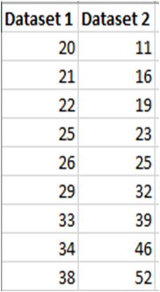
Range
The range is the difference between the highest and lowest values within a set of numbers.

Slide 30
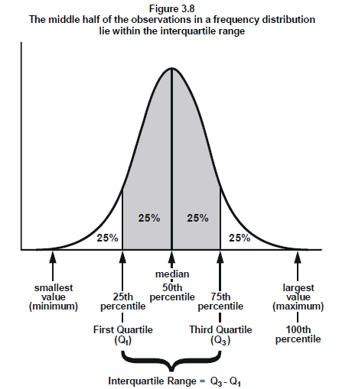
Interquartile Range (IQR)Range
The interquartile range is the middle half of the data.
Mathematically the interquartile range includes the 50% of data points that fall between Q1 and Q3.

Slide 31
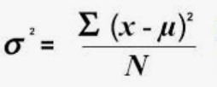
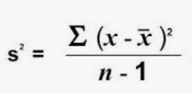
Variance(σ²)
Variance is the average squared difference of the values from the mean.
Unlike previous measures of variability, the variance includes all values in the calculation by comparing each value to the mean.

Slide 32
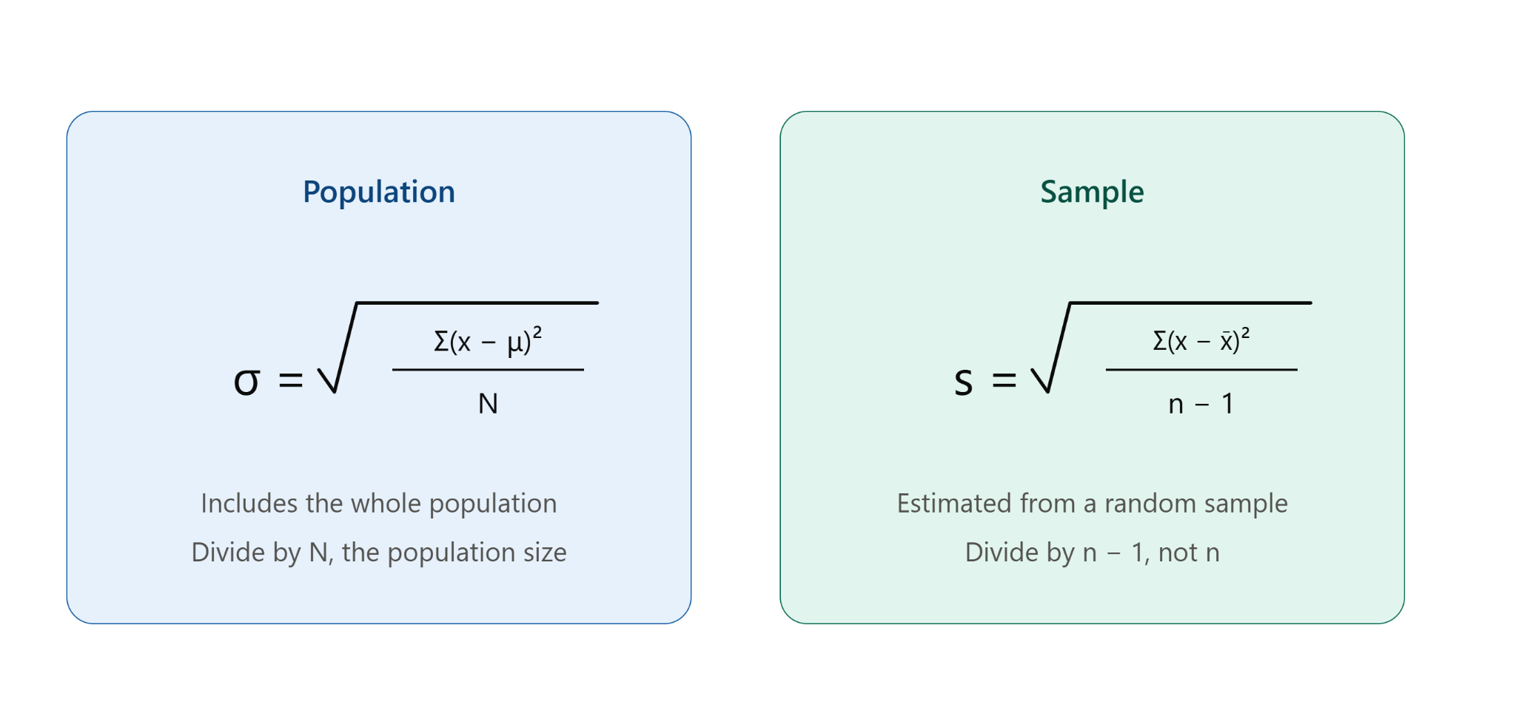
Standard Deviation (σ)

Slide 33
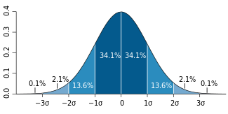
Percentile
A percentile (or a centile) is a measure used in statistics indicating the value below which a given percentage of observations in a group of observations fall.

Slide 34
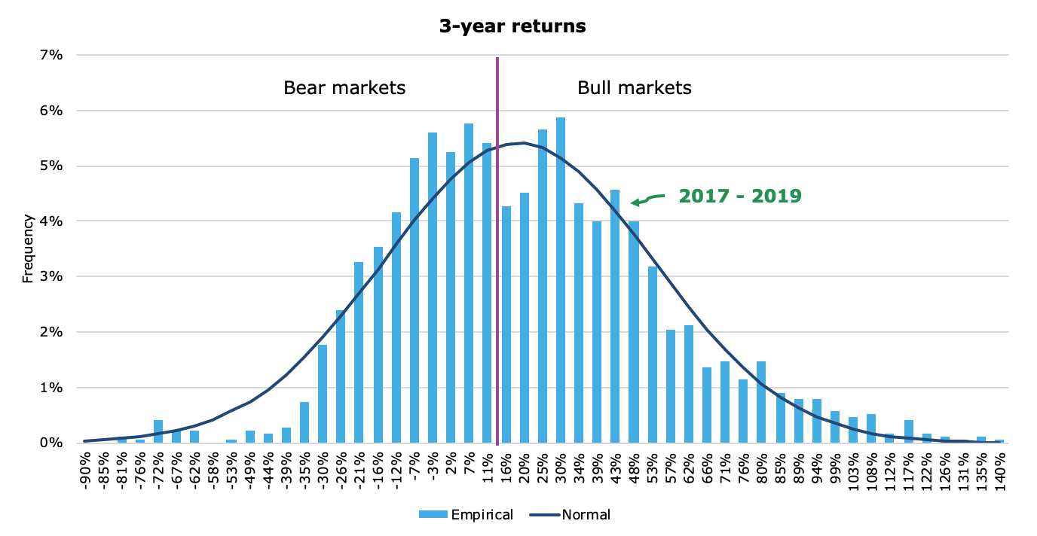
Distributions
The graphical representation of all observations is known as distribution

Slide 35
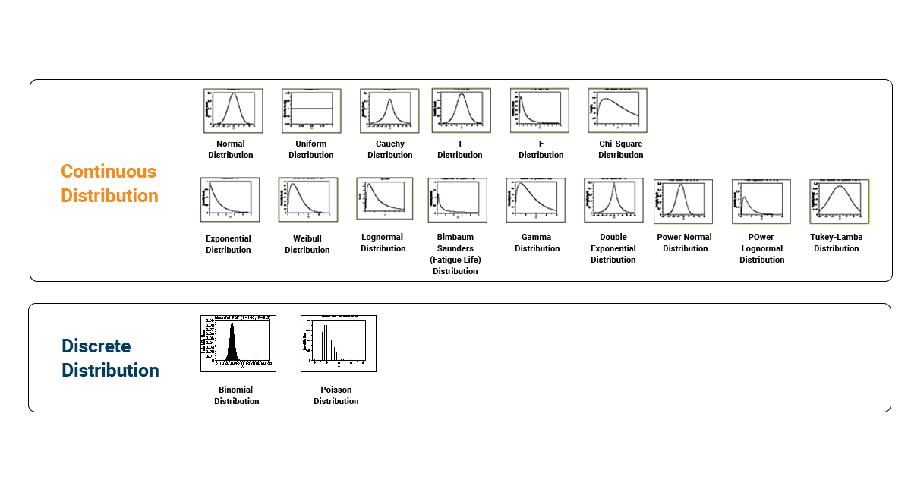
Types Of Distributions

Slide 36
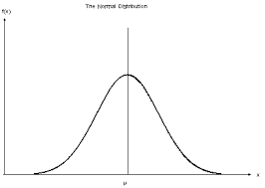
Normal Distribution
Normal distribution, also known as the Gaussian distribution, is a probability distribution that is symmetric about the mean, showing that data near the mean are more frequent in occurrence than data far from the mean.

Slide 37
Properties Of Normal Distribution
Empirical Rule
Distortion in Normal Distribution
Central Limit Theorem
Standard Normal Distribution
Outliers
QQ plot
Log,Sqrt,Boxcox transformation

Slide 38
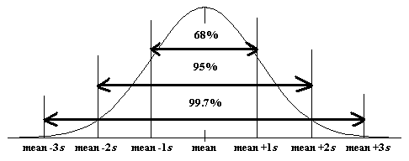
Empirical Rule
The empirical rule states that for a normal distribution, nearly all of the data will fall within three standard deviations of the mean. The empirical rule can be broken down into three parts:
68% of data falls within the first standard deviation from the mean. (1 Sigma)
95% fall within two standard deviations. (2 Sigma)
99.7% fall within three standard deviations. (3 Sigma)
Any points lying after 3 sigma is outliers.

Slide 39
Distortion in Normal Distribution
The distortion in normally distributed curves can be quantified in 2 ways
Skewness
Kurtosis

Slide 40
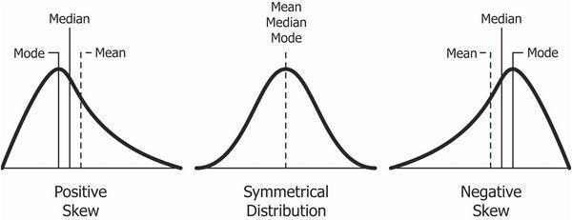
Skewness in a Distribution
Skewness is asymmetry in a statistical distribution, in which the curve appears distorted or skewed either to the left or to the right. Skewness can be quantified to define the extent to which a distribution differs from a normal distribution
If the skewness is greater than 1 or less than -1, the data is highly skewed.

Slide 41
How much Skewness and Kurtosis
If the skewness is between -0.5 and 0.5, the data are fairly symmetrical. If the skewness is between -1 and – 0.5 or between 0.5 and 1, the data is moderately skewed.
If the skewness is greater than 1or less than -1, the data is highly skewed.
A standard normal distribution has kurtosis of 3 and is recognized as mesokurtic. An increased kurtosis (>3) can be visualized as a thin “bell” with a high peak whereas a decreased kurtosis corresponds to a broadening of the peak and “thickening” of the tails.

Slide 42
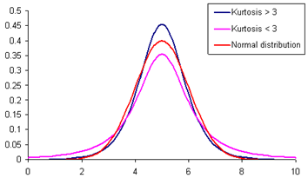
Kurtosis in a Distribution
In probability theory and statistics, kurtosis is a measure of the “peakedness" of the probability distribution of a real-valued random variable.

Slide 43
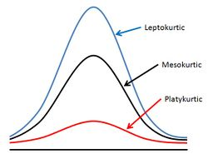

Slide 44
Which is Best—the Mean, Median, or Mode?
When you have a symmetrical distribution for continuous data, the mean, median, and mode are equal. In this case, analysts tend to use the mean because it includes all of the data in the calculations. However, if you have a skewed distribution, the median is often the best measure of central tendency.
When you have categorical or discrete data, the median or mode is usually the best choice. For categorical data, you have to use the mode.

Slide 45
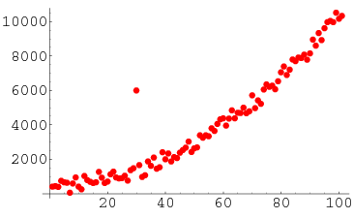
Outliers
An outlier is an observation point that is distant from other observations. An outlier may be due to variability in the measurement or it may indicate experimental error; the latter are sometimes excluded from analysis.

Slide 46
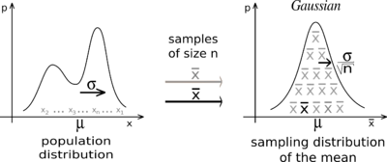
Central Limit Theorem
The central limit theorem states that the distribution of sample means approximates a normal distribution as the sample size gets larger (assuming that all samples are identical in size), regardless of population distribution shape.
CLT in one sentence "Even if I'm not normal, the average is normal"
When collecting means of the samples from any distribution, the no of samples taken for calculating the mean should be greater or equal to 30.

Slide 47
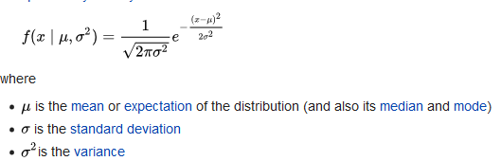
Probability Density Function
Probability density is the relationship between observations and their probability.
The overall shape of the probability density is referred to as a probability distribution, and the calculation of probabilities for specific outcomes of a random variable is performed by a probability density function, or PDF for short.
The probability density function for Normal distribution is given as
CDF: It provides a shortcut for calculating many probabilities at once. We integrate the pdf function to get the cumulative probability.

Slide 48
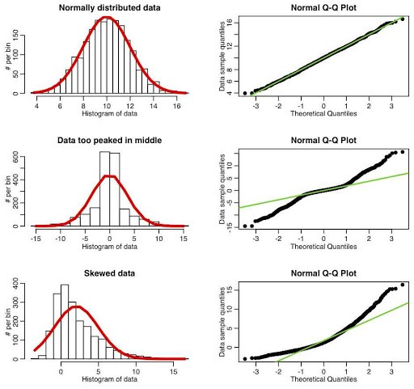
Q-Q Plots
Q-Q plots are used to identify a random variable as Normal/Gaussian or otherwise. It plots the quantiles of your dataset against the quantiles of the theoretical distribution.

Slide 49
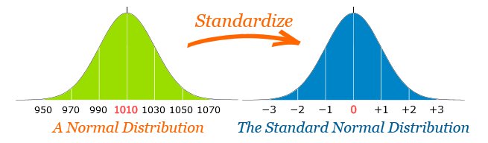
Standard Normal Distribution
The standard normal distribution is a special case of normality.
A distribution of a normal random variable is said to be standardised when the mean is zero and the standard deviation is one.

Slide 50
Z- Score / Z-Value/ Standard Score
A z-score (aka, a standard score) indicates how many standard deviations an element is above or below from the mean. A z-score can be calculated from the following formula.
z = (X - μ) / σ

Slide 51
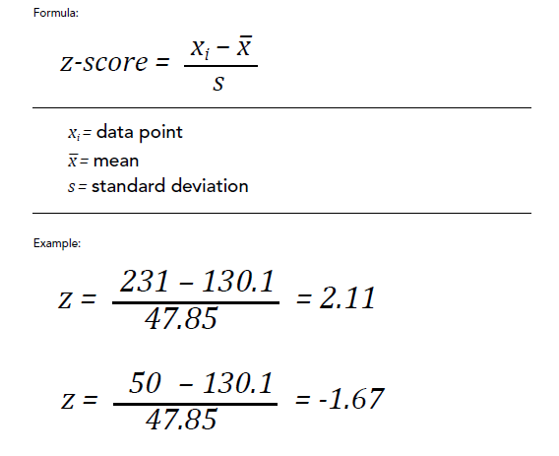
Calculating Z-Score

Slide 52
Outliers
Z-scores generally range from -3.0 to +3.0.
For bell shaped distributions, the empirical rule says 99.7% of all the data values have z-scores between -3.0 and +3.0.
We consider any z-score that is either less than -3.0 or greater than +3.0 to be an outlier.

Slide 53
Correcting Distortion in Normal Distribution
Transformation is nothing but applying a mathematical function to the data in order to change its character.
- Log Transformation [Each data point is replaced with log(x) to obtain ND]
- Square-Root Transformation [Each data point is replaced by its square root]
- Reciprocal Transformation [ It takes the inverse of x ie., 1/x]
- BoxCox Transformation [flexible version of log or square root transformations — but instead of choosing manually, Box-Cox automatically finds the best value of λ (lambda) that makes your data as normal as possible.]
Purpose: To transform the data to either reduce the skewness or to normalize the data or simply make the data easier to understand.

Slide 54
Measure of Distance
Euclidean Distance
Manhattan Distance
Minkowski Distance

Slide 55
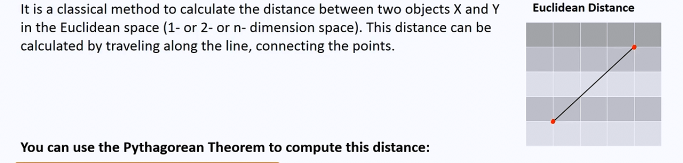
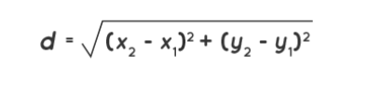
Euclidean Distance

Slide 56
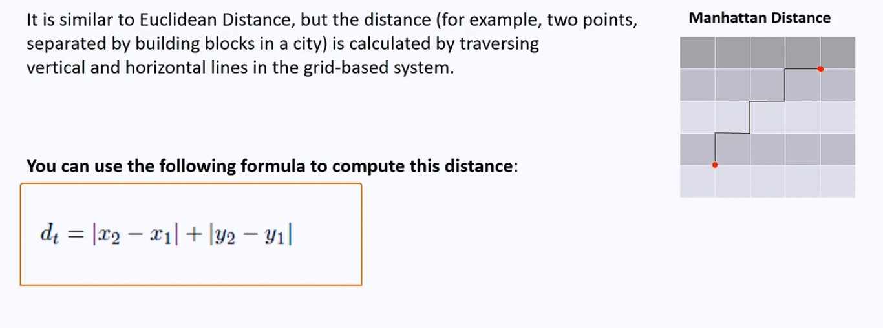
Manhattan Distance

Slide 57
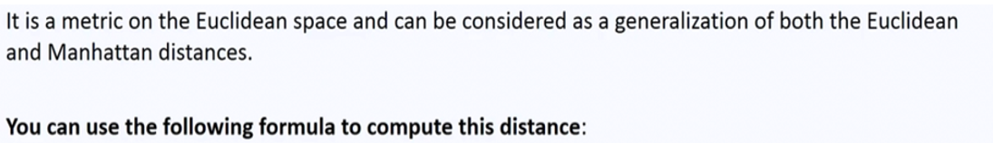
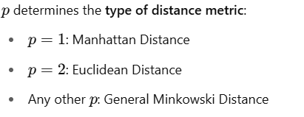

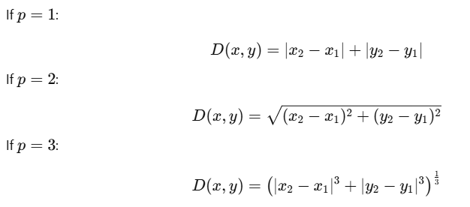

Minkowski Distance

Slide 58
Use of Distance Metrics
Statistical distances are used for several important reasons:
Outlier Detection
Clustering Analysis
Feature Selection
Data Cleaning
Dimensionality Reduction

Slide 59
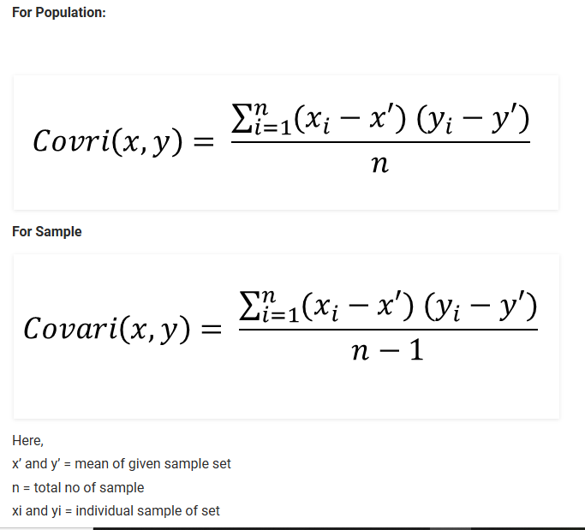
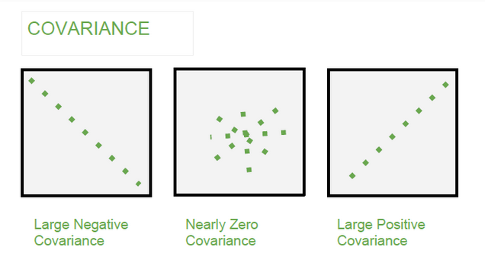
Covariance
It is the relationship between a pair of random variables where change in one variable causes change in another variable.
It can take any value between -∞ to +∞, where the negative value represents the negative relationship whereas a positive value represents the positive relationship.

Slide 60
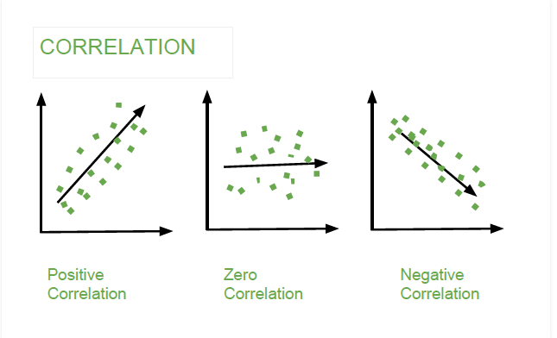
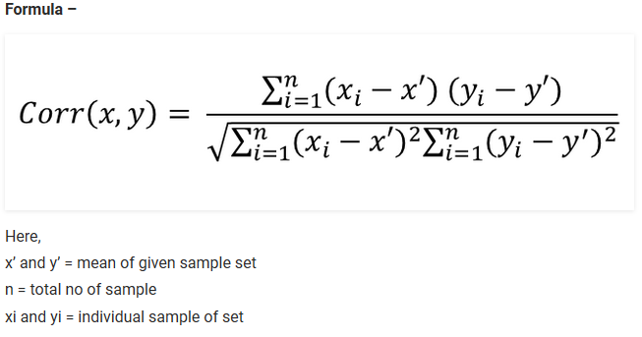
Correlation
It is the scaled version of Covariance.
Correlation is a step ahead of covariance as it quantifies the relationship between two random variables. In simple terms, it is a unit measure of how these variables change concerning each other (normalized covariance value).

Slide 61
Hypothesis Testing &
Other computational Techniques
Module - 4

Slide 62
Hypothesis Testing
Hypothesis is a statement, assumption or claim about the value of the parameter (mean, variance, median etc.).
A hypothesis is an educated guess about something in the world around you. It should be testable, either by experiment or observation.
Hypothesis Testing is a formal procedure to test whether an assumption (hypothesis) about a population is true or not.
Ex:-if we make a statement that “Dhoni is the best Indian Captain ever.” This is an assumption that we are making based on the average wins and loses team had under his captaincy. We can test this statement based on all the match data.

Slide 63
Types of Hypothesis
When a hypothesis specifies an exact value of parameter, it is simple hypothesis. For eg., A motorcycle company claiming that a certain model gives an average mileage of 100 km per litre, this is a case of simple hypothesis.
If a hypothesis specifies a range of values then it is called a composite hypothesis. For eg., Average age of students in a class is greater than 20. This statement is a composite hypothesis.

Slide 64
Null Hypothesis (H₀)
The null hypothesis is the hypothesis to be tested for possible rejection under the assumption that it is true.
Represents the default assumption.
The concept of the null is similar to innocent until proven guilty.

Slide 65
Alternate Hypothesis (H_{A})/(H1)
Represents the opposite of the null hypothesis such that both the alternate and null hypotheses together cover all possible values of the population parameter.
It is the hypothesis that researchers aim to support or prove based on evidence from sample data.
The process in hypothesis testing involves gathering evidence against the null hypothesis to support the alternative hypothesis.

Slide 66
Hypothesis Testing – Case Discussion
Consider a court of law:
The null hypothesis always begins with the assumption that the defendant is innocent.
We require evidence to reject the null hypothesis (convict the defendant).
When we collect evidence and try to reject null hypothesis, there are 2 errors that could potentially occur: Type 1 or Type 2 error.

Slide 67
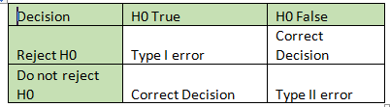
Type I and Type II Error
H0: Person is innocent H1: Person is not innocent

Slide 68
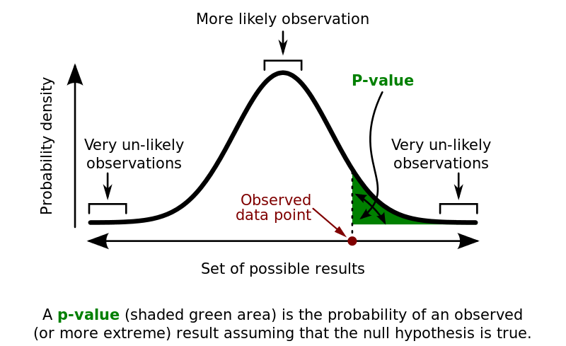
p –Value
Since we know that passing value of a test can be 1% or 5%. But we must also know what are the test score and this test score is known as p- value.
Technically p-value (probability value) is the smallest level of significance at which a null hypothesis can be rejected.
If p-value is greater than alpha, we do not reject the null hypothesis.
If p-value is smaller than alpha, we reject the null hypothesis.

Slide 69
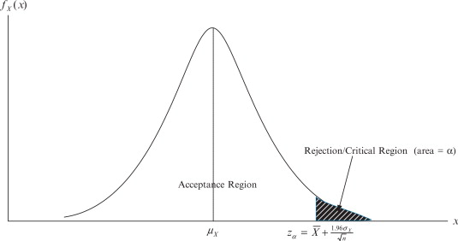
Critical Region
The critical region is that region in the sample space in which if the calculated value lies then we reject the null hypothesis.
The critical region lies in one tail or two tails on the probability distribution curve according to the alternative hypothesis.
The value of critical region is denoted by α.
It is known as level of significance. i.e what is passing criteria of test.

Slide 70
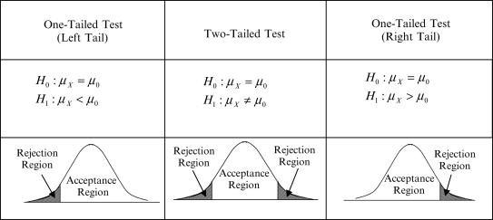
Cases Of Critical Region
Three cases of Critical Region arise.
If the alternate hypothesis gives the alternate in both directions (less than and greater than) of the value of the parameter specified in null hypothesis, it is called Two-tailed test.
E.g. H0: mean= 100 —-> H1: mean not equal to 100
Here according to H1, mean can be greater than or less than 100.
If the alternate hypothesis gives the alternate in only one direction (either less than or greater than) of the value of the parameter specified in null hypothesis, it is called One-tailed test.
E.g. H0: mean>=100 —-> H1: mean< 100

Slide 71
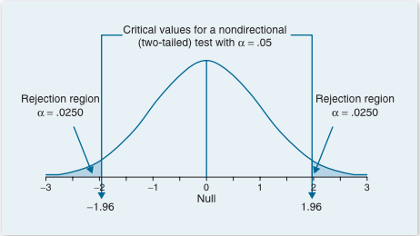
Process of Hypothesis Testing
Set up Null hypothesis and Alternate hypothesis.
Decide the level of significance (1% or 5%).
Select the test as per requirement.
Calculate the p-value.
If p-value less than level of significance, reject the null hypothesis.
If p-value more than level of significance, accept the null hypothesis.

Slide 72
Types of Hypothesis Tests
Parametric Tests:-Those test which considers the shape of distribution of sample.
Non – Parametric Tests:-Those test which do not considers the shape of distribution of sample.

Slide 73
Applications of Hypothesis Testing
Feature Selection
Model Evaluation & Selection
Hyper Parameter Tuning
Anomaly Detection

Slide 74
Hypothesis Tests:-Parametric
Z test
T/Student’s T test
Paired t Test
One Way ANOVA

Slide 75
Hypothesis Tests:-Non Parametric
Chi Square Test
Mann-Whitney Test
Wilcoxon Signed-Rank Test
Kruskal-Wallis Test
Friedman’s ANOVA

Slide 76

T-test
A t-test is an analysis of two populations means through the use of statistical examination; a t-test with two samples is commonly used with small sample sizes, testing the difference between the samples when the variances of two normal distributions are not known.
This helps in finding the association between Categorical and Continuous features.
X -> Mean of sample set
μ -> Mean of Population
S -> Standard deviation of sample
n -> Sample size

Slide 77
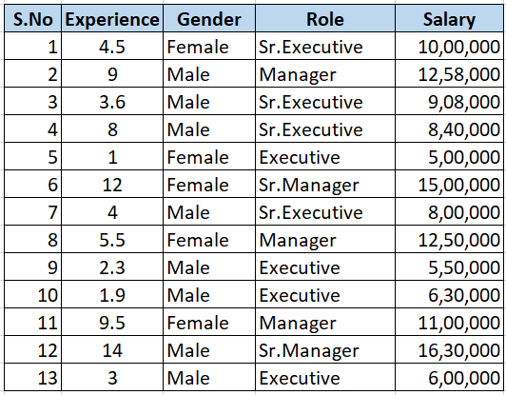
T-test

Slide 78
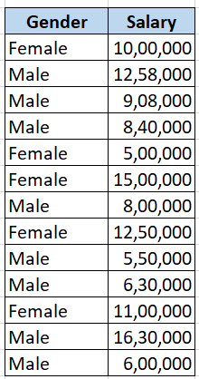
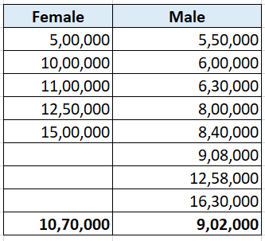
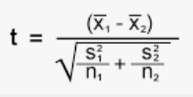
T-test
The T-Test helps to determine whether there is a statistically significant difference in the average salaries between these two groups.
H0: There is no significant difference between two groups.

Slide 79

Paired T-test
The paired t-test is performed when the samples typically consist of matched pairs of similar units, or when there are cases of repeated measures.
For example, there may be instances of the same patients being tested repeatedly—before and after receiving a particular treatment. In such cases, each patient is being used as a control sample against themselves.

Slide 80
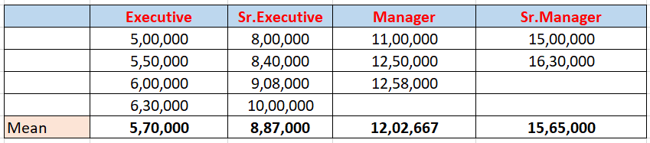
One-Way ANOVA
The one-way analysis of variance (ANOVA) is used to determine whether there are any statistically significant differences between the means of three or more independent (unrelated) groups. Eg.,
Within Group Variance - Values within the group are close to each other
Between Group Variance - Values between groups are not close to each other

Slide 81
One-Way ANOVA
If the within-group variation is less and between-group variation is high, then it means this feature impacts the target variable. Hence it is an important feature.

Slide 82
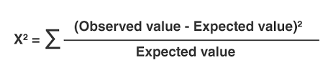

Chi-Square Test
Chi-square test can be used for categorical features in a dataset. We calculate Chi-square between each feature and the target and select the desired number of features with best Chi-square scores. It determines if the association between two categorical variables of the sample would reflect their real association in the population. Chi- square score is given by
Observed frequency = No. of observations of class
Expected Frequency = (Row Total * Column Total)/N
The expected values for each combination represents the frequency assuming there’s no relationship between the 2 variables.

Slide 83
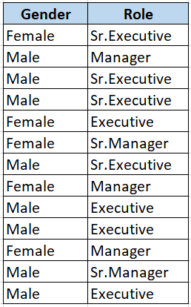

Contingency Table:
Assuming a Significance level of 0.05
We compare the contingency table’s observed values with expected values,
Chi-squared statistic = 1.733
Degrees of freedom df = (2-1) * (4-1) = 3
P-value = 0.6295
Since P-value >> 0.05, we accept the Null hypothesis.

Slide 84

Refer & Earn
up to ₹ 5,000/- per referral

